Slide 1
git
ow

Slide 2
Agenda
Version control
Git
Github
Git vs Github
Git overview and terms

Slide 3
Version control
Version control is a system that record changes to a files or set of files over the time that you can recall specific version
It allows you to revert selected files back to a previous state , revert the entire project to a previous state

Slide 4
What is Git
Git is a version control system that you can download onto your computer
Git allow developer to collaborate with other developers on a coding project or work on your own project.
Git software has to install on your system
Check git --version

Slide 5
What is github
GitHub is a product that allows you to host your Git projects on a remote server somewhere (or in other words, in the cloud).
It's important to remember that GitHub is not Git. GitHub is just a hosting service. There are other companies who offer hosting services that do the same thing as GitHub, such as Bitbucket and GitLab.

Slide 6
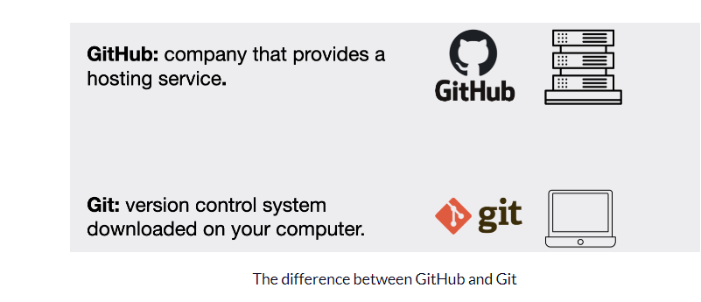
..

Slide 7
overview
Git is a distributed version control system that allows multiple developers to work on the same project simultaneously.
It keeps track of all changes made to a file or a set of files, allowing you to easily roll back to a previous version if needed. Here are some basic terms of Gits
Repository
Commit
Push
Pull
Branch
Merge

Slide 8
How to Prepare your Project Folder in Git
To use Git we need to have a project that we want to version control. This can either be a new project or an existing project.
If it is a new project, then we need to create a new project folder (hint: we can use the mkdir command) and then navigate into that project folder in the terminal.
If we were to choose an existing project then we simply navigate into that project folder in the terminal.

